Slide 1


Lesson 4
Relational Fields
Fields Computation
Fields Onchange

Slide 2
Relational Fields

Slide 3


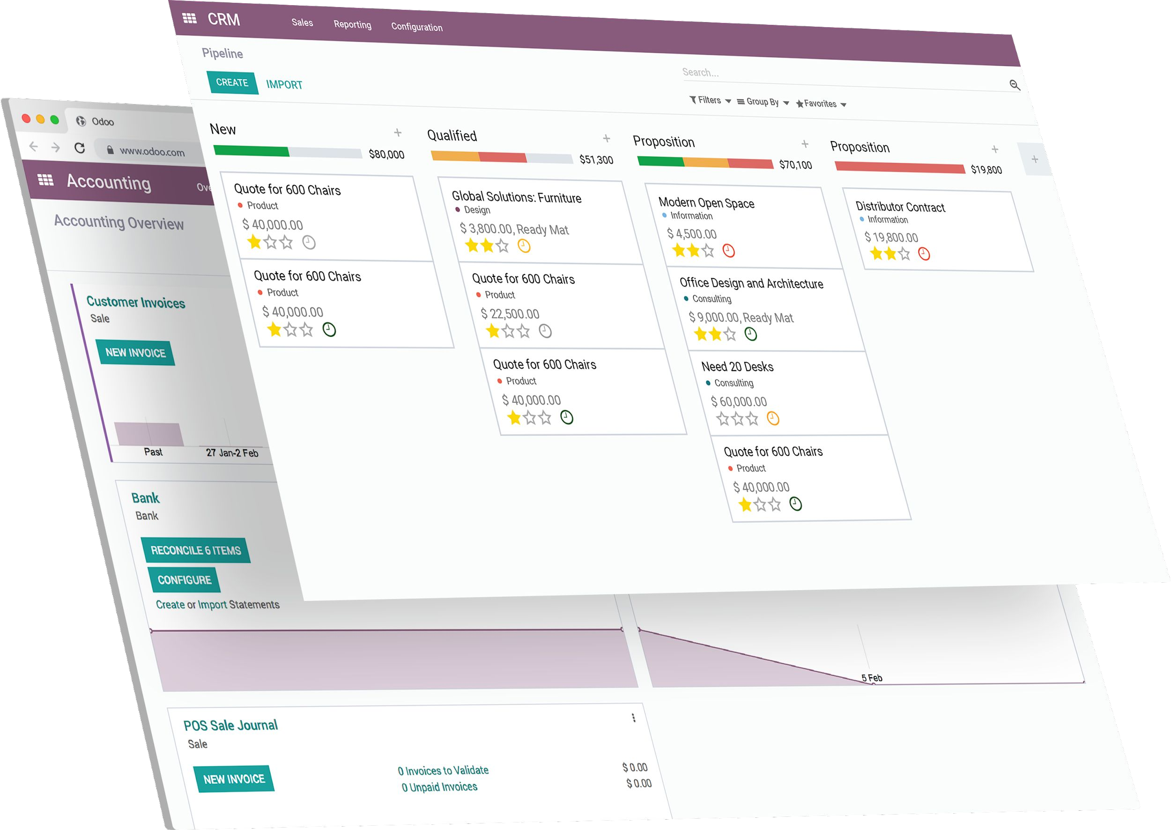




Relations between Models
Many to one (Many2one)
One to many (One2many) Many to many (Many2many)

Slide 4


Many to one
A book can have one
author
An author can write
multiple books
field_id = fields.Many2one(comodel_name="comodel.name", string="Field")
field_id = fields.Many2one("comodel.name", string="Field")

Slide 5


One to many
one2many is the inverse of a many2one
An author can write
multiple books
A book can have one
author
field_ids = fields.One2many("comodel.name", "inverse_name_id", string="Field")
One2many is a virtual relationship, there must be a Many2one field defined in the comodel

Slide 6


Many to many
adventure
Books can have
multiple categories
Categories can include
multiple books
sci-fi
thriller
field_ids = fields.Many2many("comodel.name", string="Field")

Slide 7
Fields Computation

Slide 8



Compute deﬁnition
from odoo import fields, models
class TestModel(models.Model):
_name = "test.model"
_description = "Test Model"
amount = fields.Float()
total = fields.Float(compute="_compute_total")
def _compute_total(self):
for rec in self:
rec.total = 10 * rec.amount
Create a python method
In the field attributes, set compute with the name of this method

Slide 9





Compute information
compute methods are private
name starts with an underscore
def _my_method(self)
computed fields are readonly by default
computed fields are not stored by default.
So not possible to search
Easy fix → store value
Other solution exist (search method) but not in this training

Slide 10




Recordset (self)
Compute can be triggered for multiple records at the same time
self will include one or more than one object.
danger for the result
amount = fields.Float()
total = fields.Float(compute="_compute_total")
def _compute_total(self):
self.total = 10 * self.amount

Slide 11


Recordset (self)
Compute can be triggered for multiple records at the same time
self will include one or more than one object.
Solution: iterating over self to give values one by one
amount = fields.Float()
total = fields.Float(compute="_compute_total")
def _compute_total(self):
for rec in self:
rec.total = 10 * rec.amount

Slide 12



Dependencies
Desired result can depend on other field(s)
Recompute if those change
Define dependencies using api decorator "depends" on method
from odoo import api, fields, models
class TestModel(models.Model):
_name = "test.model"
_description = "Test Model"
amount = fields.Float()
total = fields.Float(compute="_compute_total")
@api.depends("amount")
def _compute_total(self):
for rec in self:
rec.total = 10 * rec.amount

Slide 13



Related compute
from odoo import api, fields, models
Result desired can also depend on field(s) from other models
class TestModel(models.Model):
_name = "test.model"
_description = "Test Model"
partner_total = fields.Float(compute="_compute_partner_total") partner_id = fields.Many2one("res.partner")
Can have complex relation in decorator and in compute
@api.depends("partner_id.amount")
def _compute_total(self):
for rec in self:
rec.partner_total = 10 * rec.partner_id.amount

Slide 14


Multiple records
Danger with multiple relation
list of records need to get their data in a list
from odoo import api, fields, models
class TestModel(models.Model):
_name = "test.model"
_description = "Test Model"
partner_total = fields.Float(compute="_compute_partner_total") partner_ids = fields.One2many("res.partner")
@api.depends("partner_ids.amount")
def _compute_total(self):
for rec in self:
rec.partner_total = sum(rec.partner_ids.amount)

Slide 15

Multiple records
Danger with multiple relation
list of records need to get their data in a list
from odoo import api, fields, models
class TestModel(models.Model):
_name = "test.model"
_description = "Test Model"
partner_total = fields.Float(compute="_compute_partner_total") partner_ids = fields.One2many("res.partner")
Using ORM "mapped"
operator
@api.depends("partner_ids.amount")
def _compute_total(self):
for rec in self:
rec.partner_total = sum(rec.partner_ids.mapped("amount"))

Slide 16






Related ﬁelds
partner_id = fields.Many2one("res.partner", string="Partner") description = fields.Char(compute="_compute_description")
@api.depends("partner_id.name")
def _compute_description(self):
for record in self:
record.description = record.partner_id.name
is equivalent to
partner_id = fields.Many2one("res.partner", string="Partner") description = fields.Char(related="partner_id.name")
related should have same type as field itself !

Slide 17




Inverse function
from odoo import api, fields, models
class TestModel(models.Model):
_name = "test.model"
_description = "Test Model"
total = fields.Float(
compute="_compute_total",
inverse="_inverse_total"
amount = fields.Float()
@api.depends("amount")
def _compute_total(self):
for rec in self:
rec.total = 10 * rec.amount
def _inverse_total(self):
for rec in self:
rec.amount = rec.total / 10
We want the two fields to have an inverse relation
Using compute in both will create infinite loop
Use inverse attribute in same field as compute
)

Slide 18
Fields Onchange

Slide 19





Onchange
from odoo import api, fields, models
Field recomputed instantly if another field is modified in the view
class TestModel(models.Model):
_name = "test.model"
_description = "Test Model"
name = fields.Float()
Defined using api decorator "onchange" on method
partner_id = fields.Many2one("res.partner")
@api.onchange("partner_id")
def onchange_partner_id(self):
self.name = "House - %s" % (self.partner_id.name)
Never use onchange for business logic !
onchanges are only triggered updating fields in the form view

Slide 20



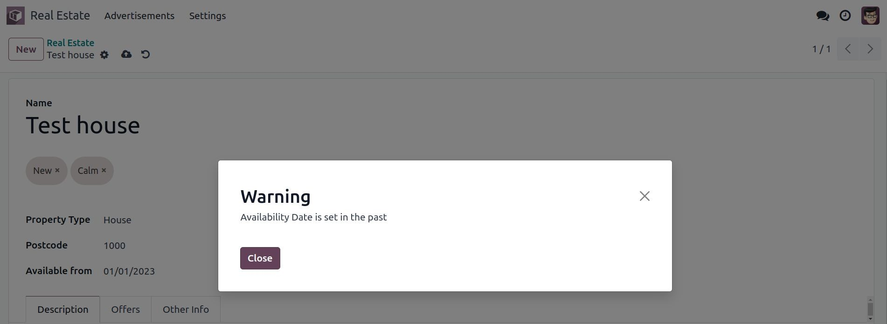


Non blocking warning
Return non-blocfiing pop-up warning in onchange on condition
amount = fields.Float()
@api.onchange("amount")
def _onchange_amount(self):
if self.amount < 0:
return {"warning": {"title": _("Warning"), "message": _("Amount is negative")}}

Slide 21

Exercise
Add the Real Estate Property Type table.
Create the estate.property.type model and add the following field:
Lesson 4
New model
Field | Type | Attributes
name | Char | required
Add the setting menus and a submenu redirecting to this new model (as displayed in this section’s Goal in the next slide)
Add the field property_type_id into your estate.property model and its form, tree and search views
This exercise is a good recap of the previous chapters: you need to create a model, set the model, add an action and a menu, and create a view.
Tip: do not forget to import any new Python files in init .py, add new data files in manifest.py or add the access rights

Slide 22
Exercise
Lesson 4
New model
Many2one
Add a buyer (res.partner) and a salesperson (res.users) to the
estate.property model.
They should be added in a new tab of the form view, as depicted in this section’s Goal in the next slide.
The default value for the salesperson must be the current user. The buyer should not be copied.
Tip: to get the default value, look at an example here.

Slide 23

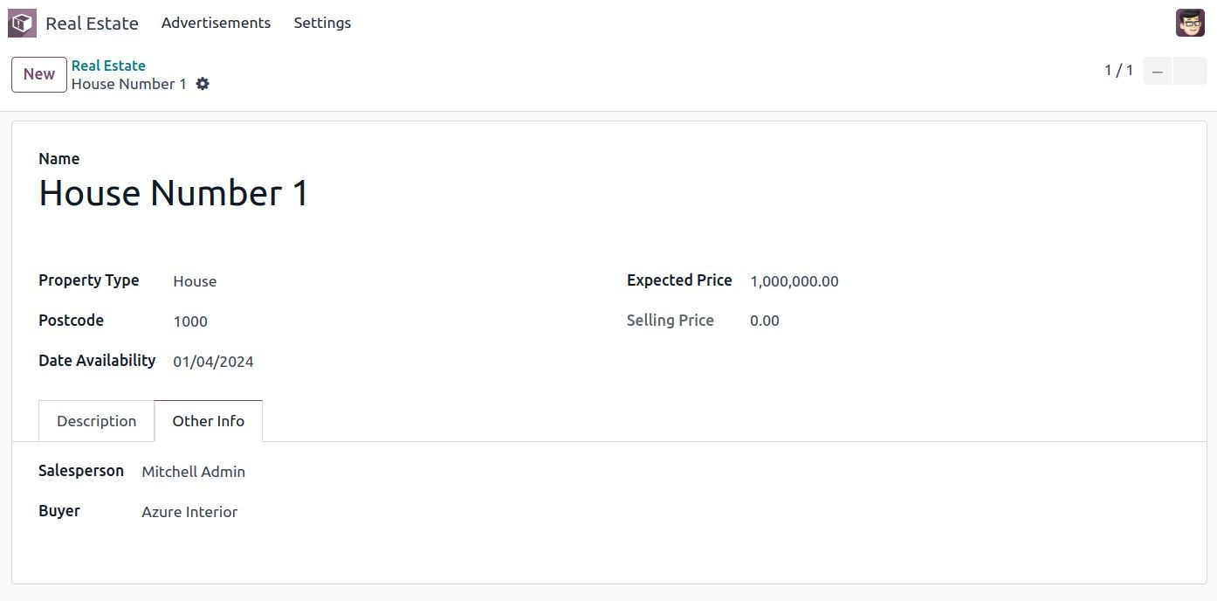
Exercise
Lesson 4
New model
Many2one

Slide 24
Exercise
Add the Real Estate Property Offer table.
Create the estate.property.offer model and add the following fields:
Create a tree view and a form view with the price, partner_id and status fields.
-> No need to create an action or a menu.
Add the field offer_ids to your estate.property model and in its form view as depicted in this section’s Goal.
Lesson 4
New model
Many2one
One2many
Field
Type
Attributes
Values
price
Float
status
Selection
no copy
Accepted, Refused
partner_id
Many2one (res.partner)
required
property_id
Many2one (estate.property)
required

Slide 25

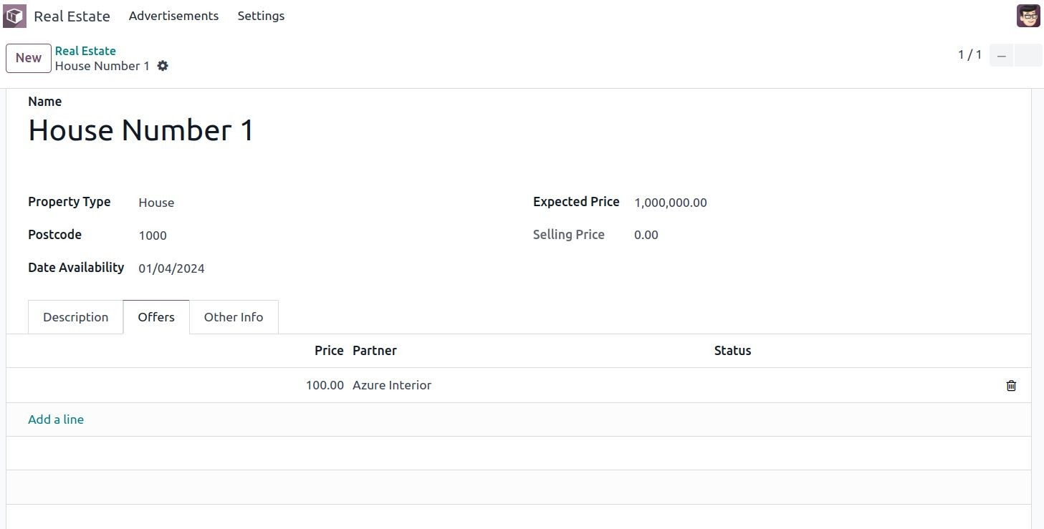
Exercise
Lesson 4
New model
Many2one
One2many

Slide 26
Exercise
Add the Real Estate Property Tag table.
Lesson 4
New model
Many2one
One2many
Many2many
Create the estate.property.tag model and add the following field:
Add a menu to get to a tree view of this model in Settings
Add the field tag_ids to your estate.property model and in its form and tree views
Tip: in the view, use the widget="many2many_tags" attribute as demonstrated
Field | Type | Attributes
name | Char | required
The widget attribute will be explained in detail in a later chapter of the training.

Slide 27

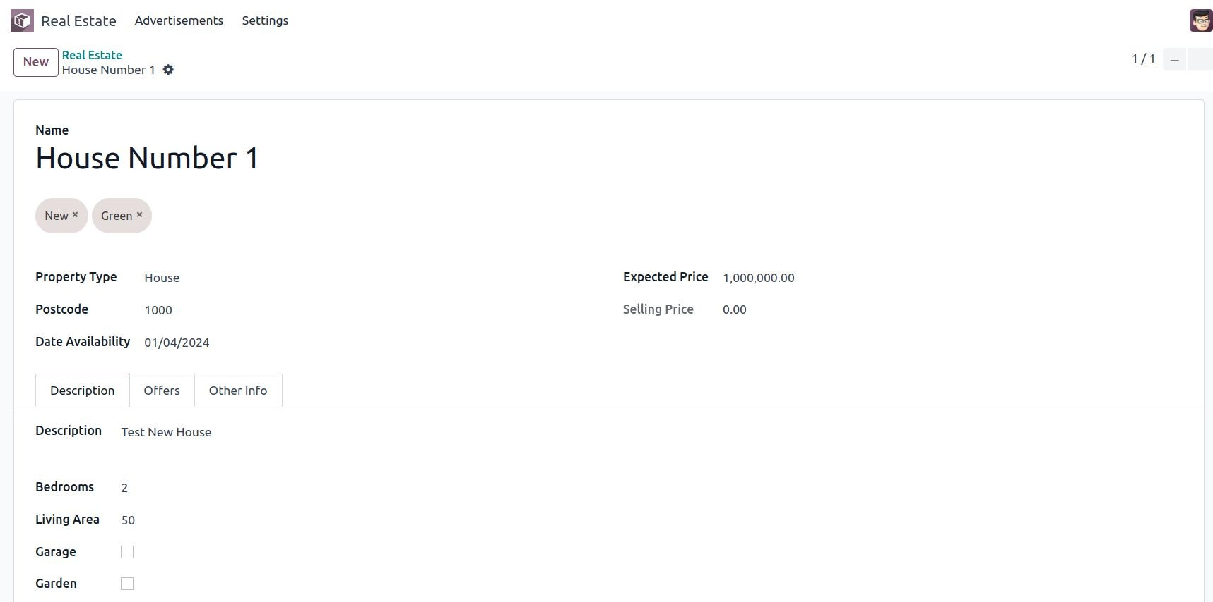
Exercise
Lesson 4
New model
Many2one
One2many
Many2many

Slide 28
Exercise
Lesson 4
New model
Many2one
One2many
Many2many
Computation
Compute the total area of a property.
Add the total_area field to estate.property. It is defined as the sum of the living_area and the garden_area.
Add the field in the form view.

Slide 29
Exercise
Lesson 4
New model
Many2one
One2many
Many2many
Computation
Compute the best offer of a property.
Add the best_price field to estate.property. It is defined as the highest (i.e. maximum) of the offers’ price.
Add the field in the form view.

Slide 30
Exercise
Lesson 4
New model
Many2one
One2many
Many2many
Computation
Related Fields
Add the property type in the offers tree view.
Add the property_type_id field to estate.property.offer. We can define it as a related field on property_id.property_type_id and set it as stored.
Add a menu under Advertisement linking to the tree view. Display the fields: property_id,partner_id,price,status,property_type_id

Slide 31
Exercise
Compute a validity date for offers.
Add the following fields to the estate.property.offer model:
Lesson 4
New model
Many2one
One2many
Many2many
Computation
Related Fields
Inverse
Field | Type | Default
validity | Integer | 7
date_deadline | Date
Where date_deadline is a computed field which is defined as the sum of two fields from the offer: the create_date and the validity. Define an appropriate inverse function so that the user can set either the date or the validity.
Add the fields in the form view and the list view
Note : compute updated after save master record
Tip: the create_date is only filled in when the record is created, therefore you will need a fallback to prevent crashing at time of creation.

Slide 32
Exercise
Create an onchange in the estate.property model in order to set values for the garden area and orientation when garden is set to True.
When unset, clear the fields.
Lesson 4
New model
Many2one
One2many
Many2many
Computation
Related Fields
Inverse
Onchange
Set values for garden area and orientation.

Slide 33
Exercise
Lesson 4
New model
Many2one
One2many
Many2many
Computation
Related Fields
Inverse
Onchange
Raise a soft warning.
Create a soft warning in the estate.property model if the field
date_availability is set to a date prior than today’s.

